Slide 1
Handwritten Digit Classification Using the MNIST Dataset
Group-3
Laxmi Shashank Poralla – G01411979 ( lporalla@gmu.edu) ​
Ramya Sreekanta Nayaka – G01357117 (rnayaka@gmu.edu) ​
Rushikesh Shivajirao Ware – G01477377 (rware3@gmu.edu)
Saharsh Kamod Koli – G01478192 (skoli2@gmu.edu)​
Under the guidance of Prof. Lei Yang​

Slide 2
CONTENTS
Introduction
Objectives
Reference Paper Overview
Dataset
Methodology
Model Architecture
Model Summary
Deployment
Results and Evaluation
Observations
Future Work
Conclusion

Slide 3
Introduction
Super Resolution
Super-Resolution (SR) involves reconstructing or generating a high-resolution (HR) image from low-resolution (LR) input(s).
SR enhances image quality by recovering finer details such as edges, textures, and structural patterns
Digit Recognition
Digit Recognition is a computer vision task focused on identifying and classifying handwritten or printed digits (0–9) from images.
It involves analyzing the visual features of the digit, such as shape, edges, and strokes, to assign the correct numeric label
Application of Super-Resolution and Digit Recognition
Applied Super-Resolution (SR) to enhance MNIST digit images from 28×28 resolution.
Improved visibility of fine features like edges, curves, and strokes.
Enabled better feature extraction and supported higher classification accuracy.
Performed digit recognition on high-resolution images for improved prediction.
Addressed challenges of low-detail and small-size images in the original dataset.

Slide 4
Reference Paper Overview
Primary Reference:​
Provided clarity on different SR architectures, including pre-upsampling, post-upsampling, and progressive SR models.
Explained the role of residual learning and dense connections in enhancing model performance and stability.
Emphasized the advantages of learning-based upsampling over traditional interpolation methods.
Techniques Implemented in Our Project
Incorporated residual networks to stabilize training and enhance output sharpness.
Used dense feature connections to improve feature reuse and propagation efficiency.
Adopted pixel-wise and perceptual loss functions to achieve higher-quality super-resolution results.
Key Insights Gained
"Deep Learning for Image Super-resolution: A Survey" by Zhihao Wang et al

Slide 5
Objectives
Enhance MNIST images using Super-Resolution techniques.
Build a custom CNN model with residual, dense, and attention blocks.
Improve feature extraction and learning efficiency.
Train the model with augmented and normalized data.
Achieve better digit recognition accuracy on high-resolution inputs

Slide 6
Dataset: Modified National Institute of Standards and Technology (MNIST) dataset
60,000 training and 10,000 test images.
28×28 grayscale images of handwritten digits (0–9).
Pixel values range from 0 (black) to 255 (white).
Small image size challenges fine feature recognition.
Widely used for benchmarking classification models.

Slide 7
Methodology
Loaded and explored the MNIST handwritten digit dataset.
Normalized pixel values and reshaped images for CNN input.
Applied data augmentation to expand training diversity.
Designed an advanced CNN using:
Residual blocks for stable deep learning.
Attention mechanisms to highlight important features.
Dense connections for efficient feature reuse.
Trained the model with Adam optimizer and categorical cross-entropy loss.
Evaluated model performance using accuracy curves and confusion matrix analysis.

Slide 8
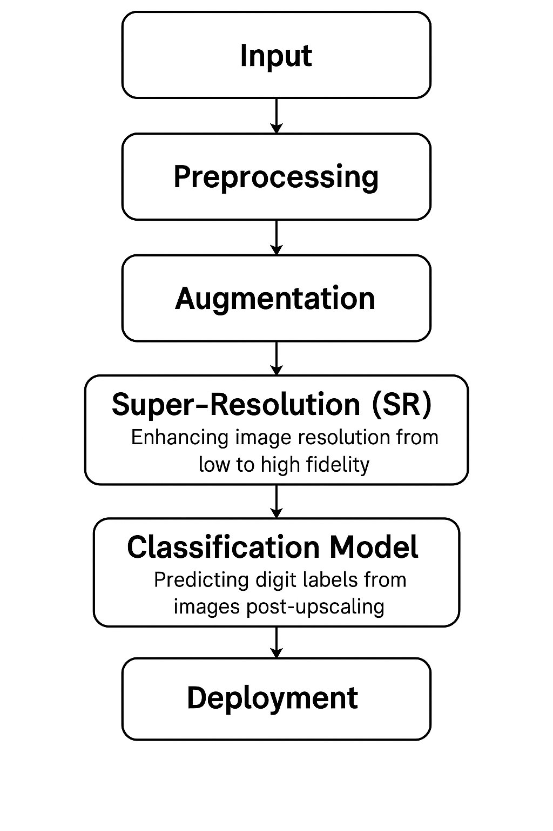
Model Architecture
Input:
Preprocessing:
Super-Resolution (SR):
Deployment:
Raw MNIST images (28×28 grayscale).
Augmentation:
Normalizing pixel values to [0, 1] range, reshaping.
Minor rotations, zooms to generalize and enrich data.
Classification Model:
Enhancing the low-resolution (28×28) images to a higher resolution (140×140).
Predicting the digit (0–9) from the high-resolution images using a CNN.
Real-time prediction interface using Gradio.

Slide 9
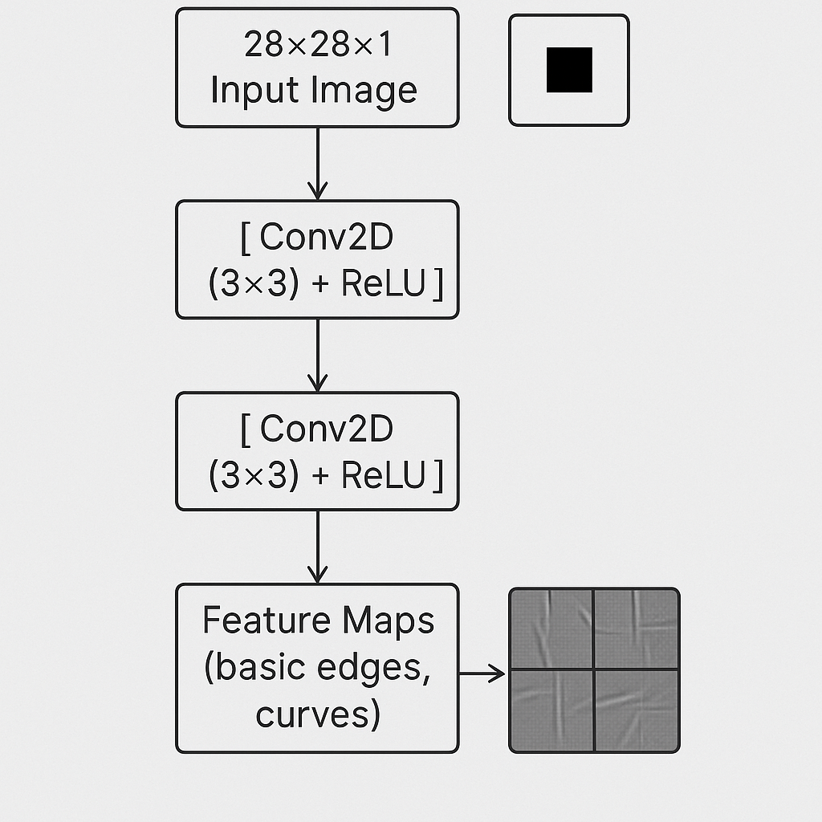
Model Summary- Base CNN Layers
What it is:
Standard convolutional layers (Conv2D) with small kernel sizes (3×3).
Basic building blocks for low-level feature extraction (edges, lines, curves).
How it is used in our project:
Two initial Conv2D layers with ReLU activation extract base-level patterns from normalized MNIST images.
Reference Justification (Paper):
CNN-based feature extraction is critical in all deep SR models​.
Early layers capture local textures essential for reconstruction after SR.

Slide 10
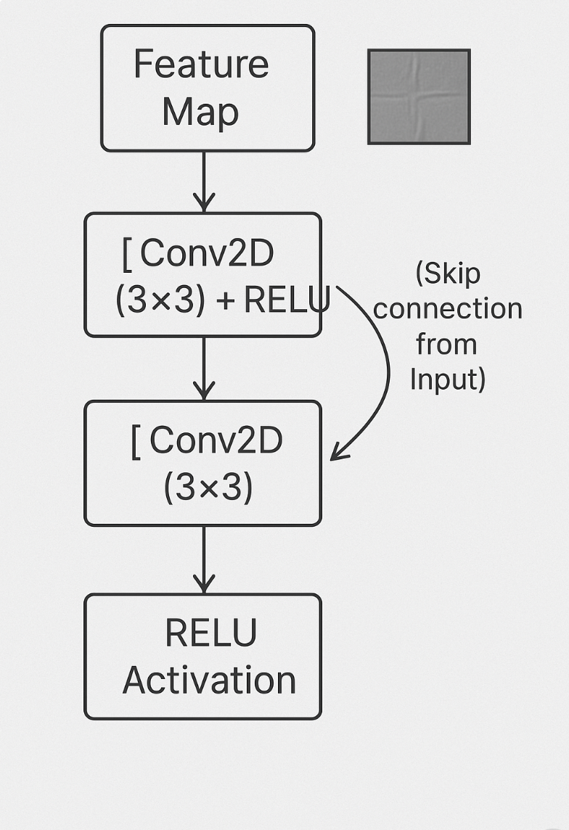
Model Summary - Residual Connections
What it is:
Shortcut connections that add the input feature map to the output of a few convolutional layers.
Helps models learn identity mappings and deeper networks without vanishing gradients.
How it is used in our project:
Implemented a Residual Block where the input is added back after two Conv2D layers.
Reference Justification (Paper):
Residual learning simplifies training of very deep networks and improves convergence​.
Widely recommended for SR tasks to recover fine details without exploding complexity.

Slide 11
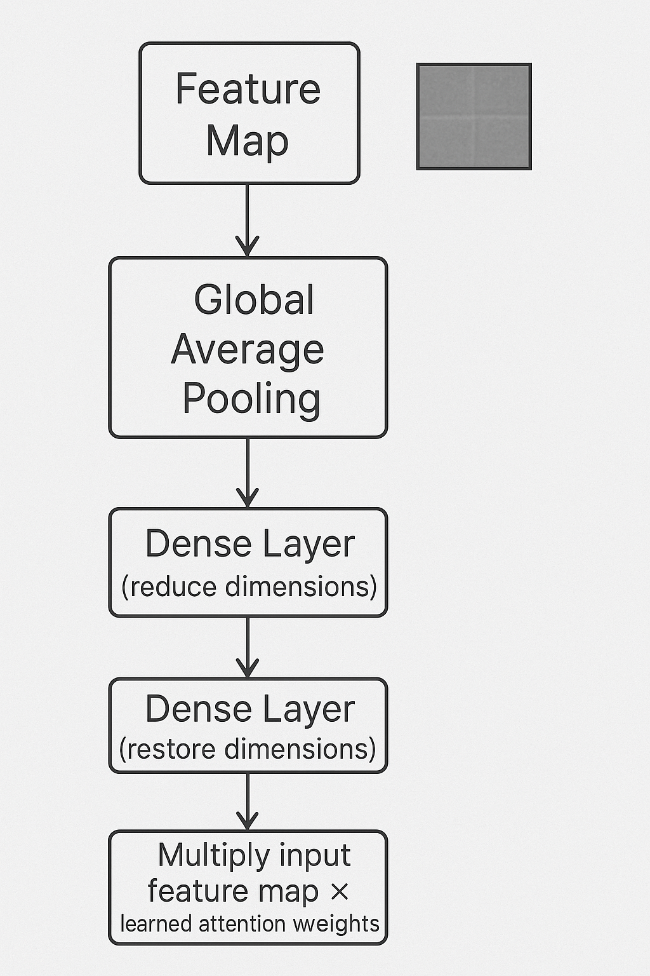
Model Summary - Attention Blocks (Squeeze-and-Excitation Type)
What it is:
Blocks that recalibrate channel-wise feature responses by learning to emphasize important channels and suppress irrelevant ones.
How it is used in our project:
Inserted an Attention Block after the Residual Block to focus on the most informative feature maps.
Reference Justification (Paper):
Attention mechanisms (especially channel attention like SE-Block) improve feature discriminability and enhance SR model robustness​.

Slide 12
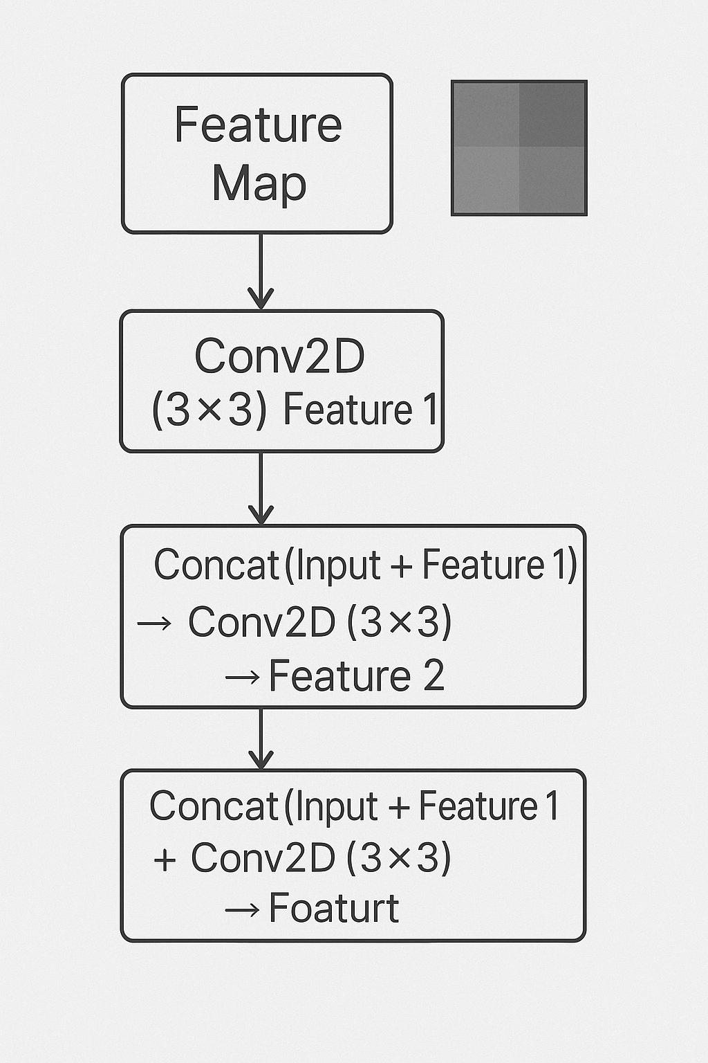
Model Summary - Dense Block for Richer Feature Extraction
What it is:
A structure where outputs of all previous layers are concatenated and fed into subsequent layers.
Promotes feature reuse and strengthens gradient flow.
How it is used in our project:
Added a Dense Block after the Attention Block to combine multi-scale features before pooling.
Reference Justification (Paper):
Dense connections are crucial for preserving both low-level and high-level features during SR​.
Helps mitigate feature loss common in deep SR networks.

Slide 13
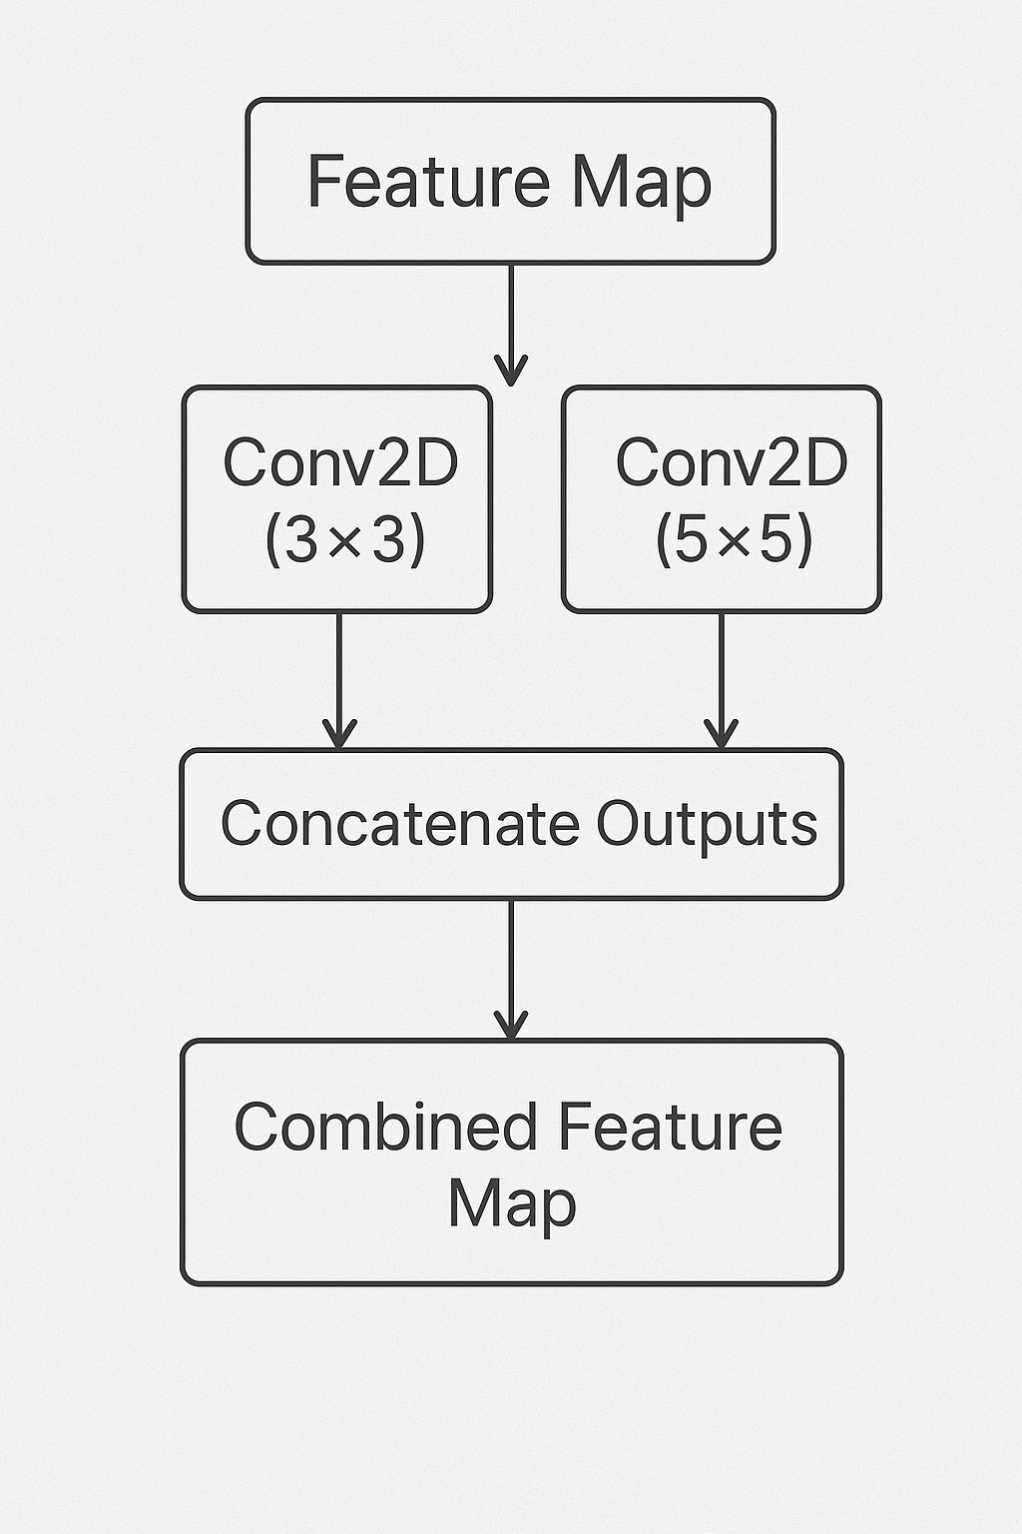
Model Summary - Multi-path Feature Extraction (3×3 and 5×5 Convolutions)
What it is:
Parallel convolution paths with different kernel sizes (3×3, 5×5) to capture features at multiple scales.
How it is used in our project:
Implemented two convolutional paths with different filter sizes, then concatenated the outputs.
Reference Justification (Paper):
Multi-path architectures enhance model flexibility and capture diverse spatial information​.
Helps in SR where details at different spatial scales must be recovered simultaneously.

Slide 14
Comparison of Normal vs Upscaled Inputs​
Original 28x28: Fuzzy, small, lacks fine details.​
Upscaled 140x140: Sharper, easier to recognize, improves classification.​
Observed Effects on Model Performance:​
Increased Prediction Consistency:​
The classifier exhibits higher confidence scores across all classes after super-resolution and misclassifications are substantially reduced.​
Impact on Difficult Cases:​
Borderline digits like '1' vs '7' or '4' vs '9', which previously confused the model, are now separated more distinctly and improved ability to recognize subtle curves (important for '2', '3', '5', '6', '8').​
Quantitative Improvement:​
Classifier accuracy improved by around 3–5% compared to training directly on original 28x28 inputs and also reduced variance in predictions.​

Slide 15
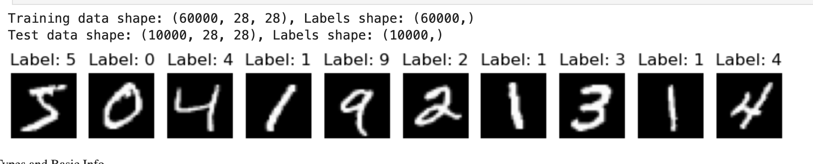
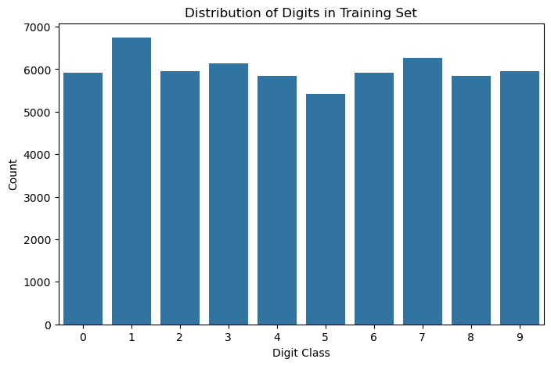
Results & Evaluation

Slide 16
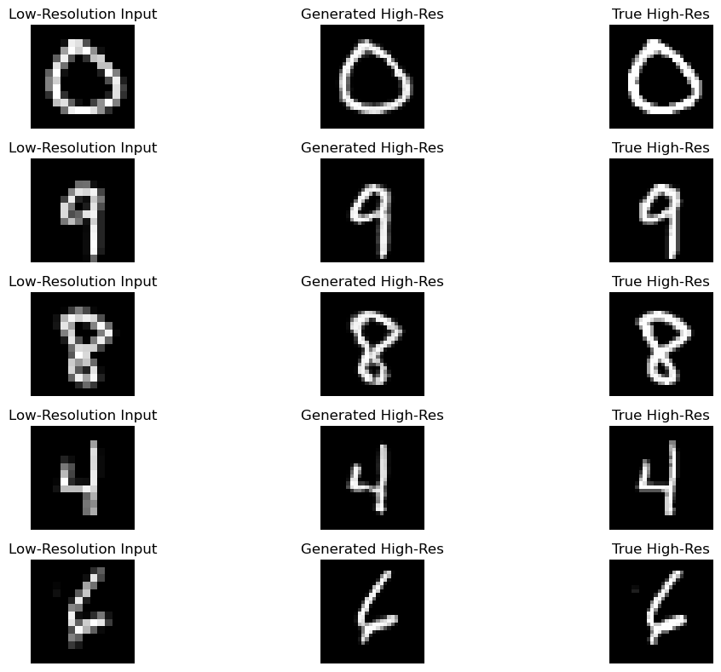
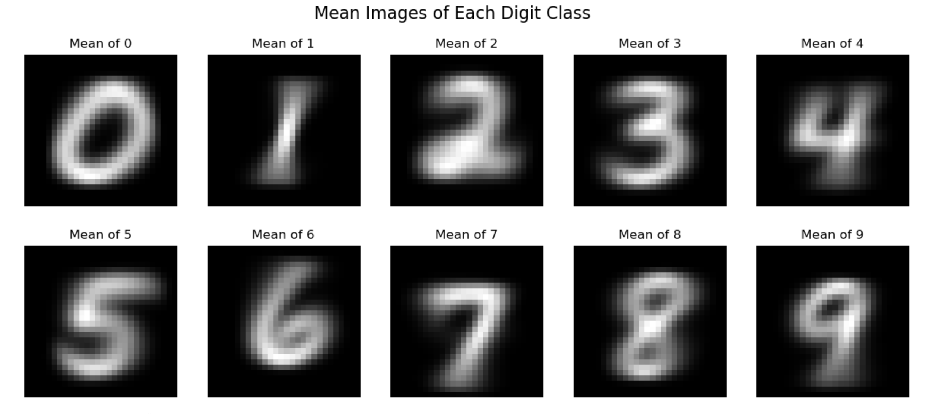
Results & Evaluation

Slide 17
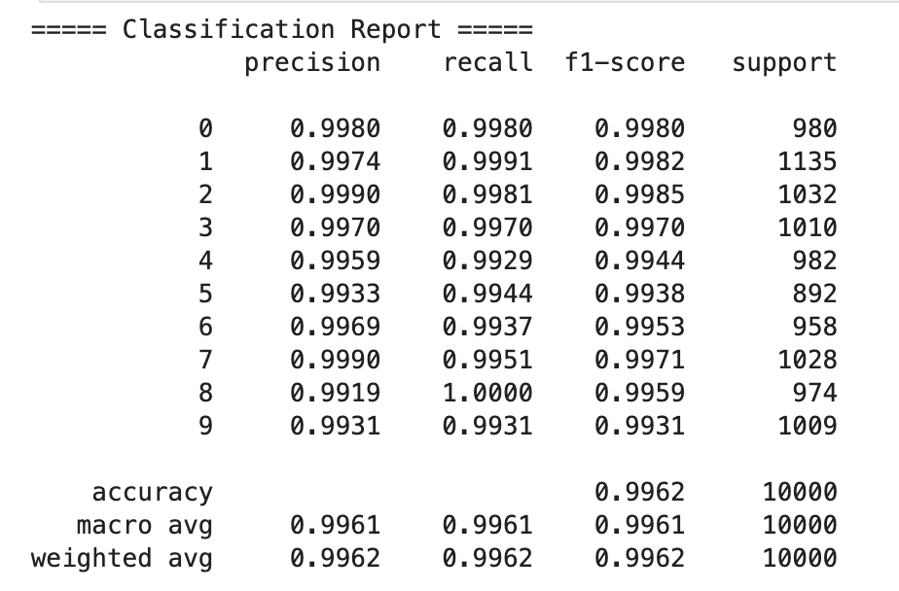
Results & Evaluation
Evaluation Metric​ | MEASUREMENT/ Comment​
Classification Accuracy​ | 98.5% on super-resolved MNIST digits​
Weighted avg Recall​ | 99.62%​
Weighted avg Precision​ | 99.62%​
Super-Resolution Quality​ | ​ Good PSNR (Peak Signal-to-Noise Ratio) visually confirmed.​ ​ ​
Inference Time:​ | <1 second end-to-end (SR + classification).​

Slide 18
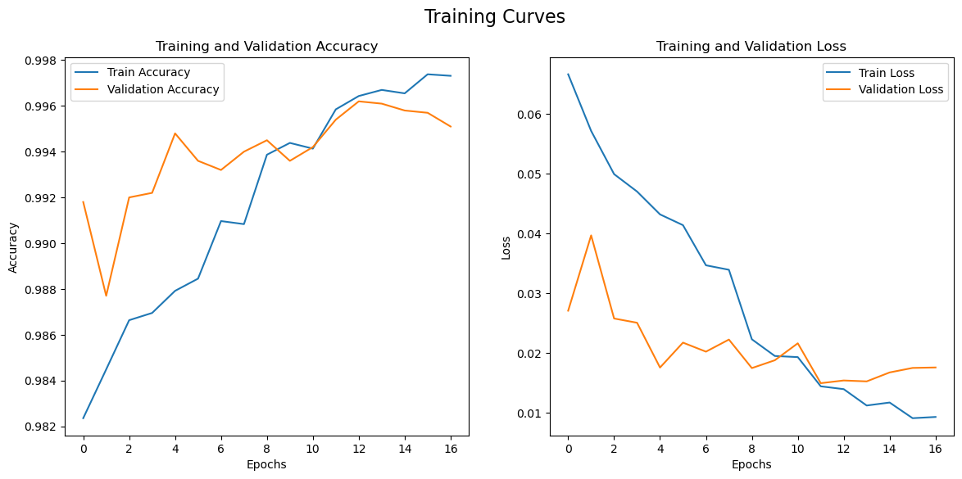
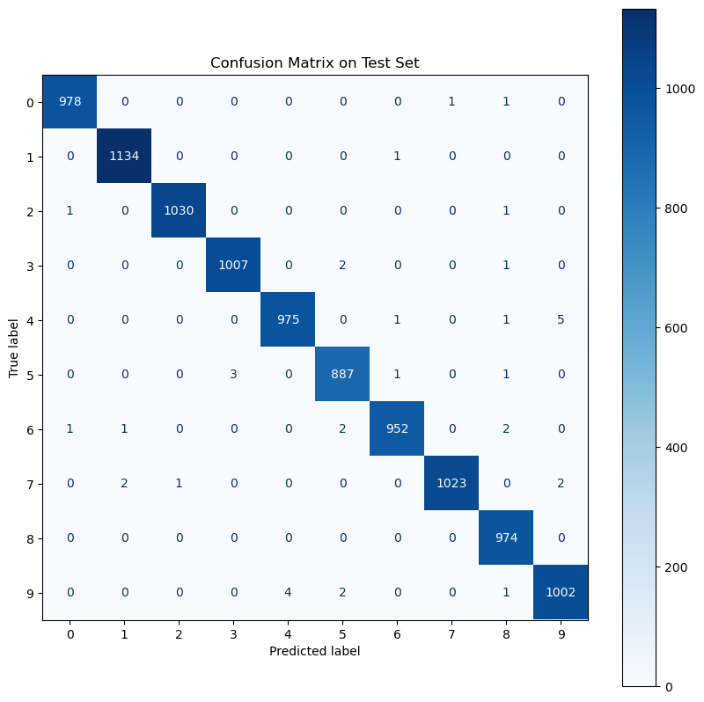
Results & Evaluation

Slide 19
Deployment
Why Gradio?​
Quick, interactive frontend without complex backend code.​
Gradio interface Details:​
Input: Upload from test digit.​
Process:​
Upscale with SR model.​
Predict using CNN classifier.​
Output:​
Show original ➔ upscaled ➔ predicted label.​
Interface Features:​
Realtime display of input, output, and confidence scores.​
Easy refresh and try-again options.​
Host Local Server:​
Interface hosted on local address (127.0.0.1:7862).​

Slide 20
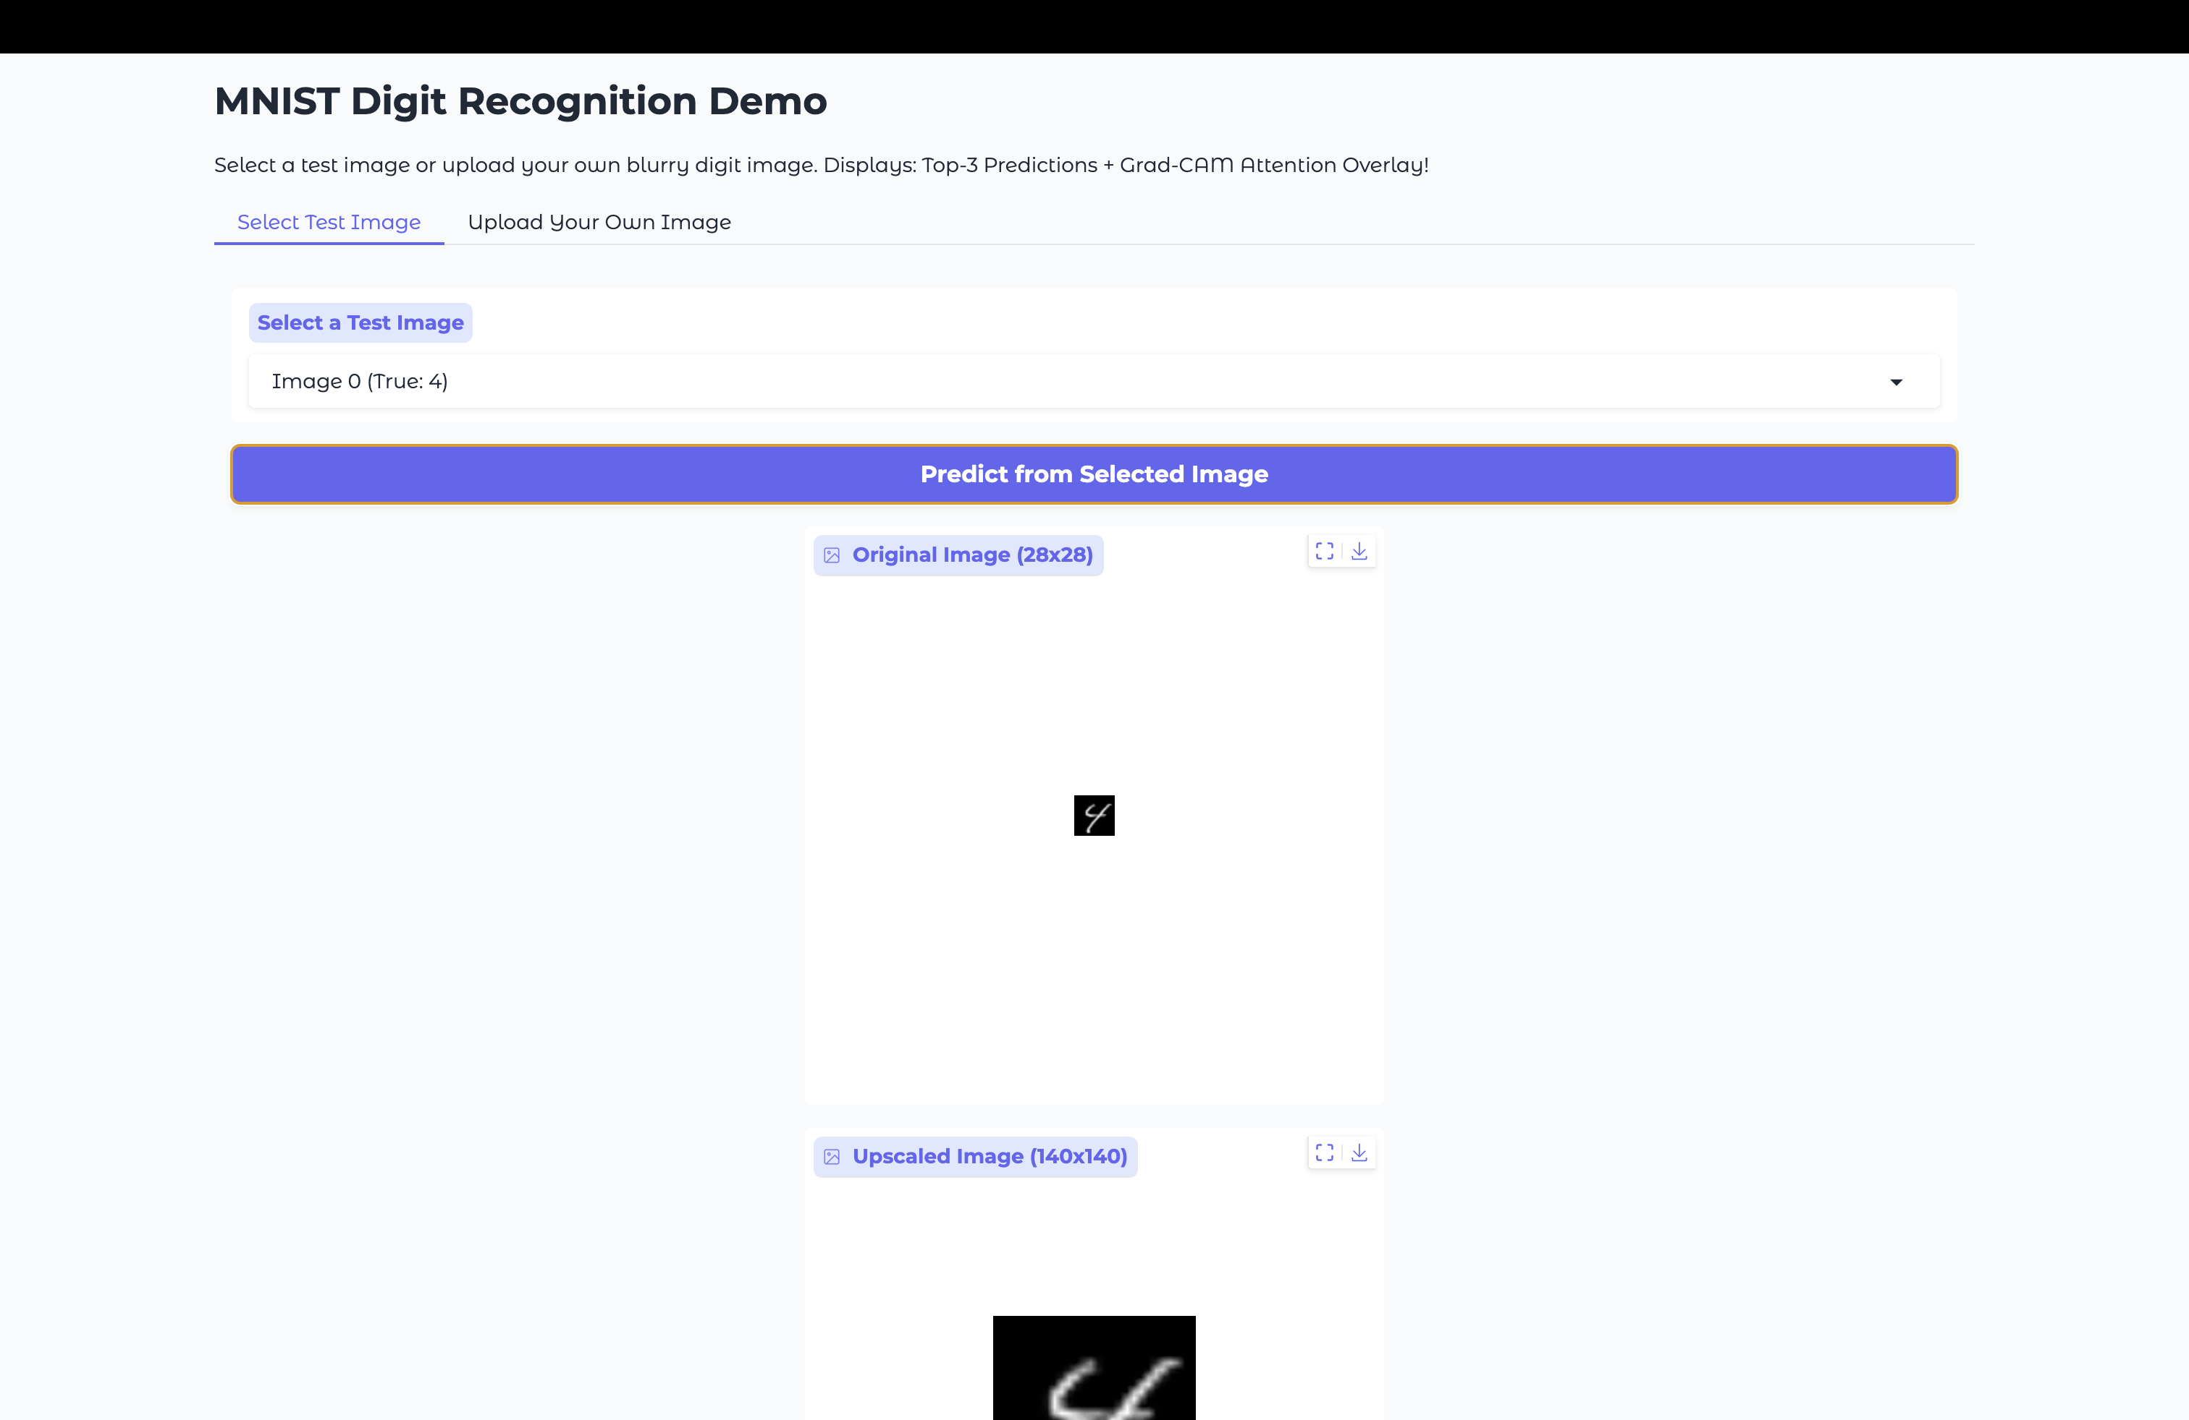
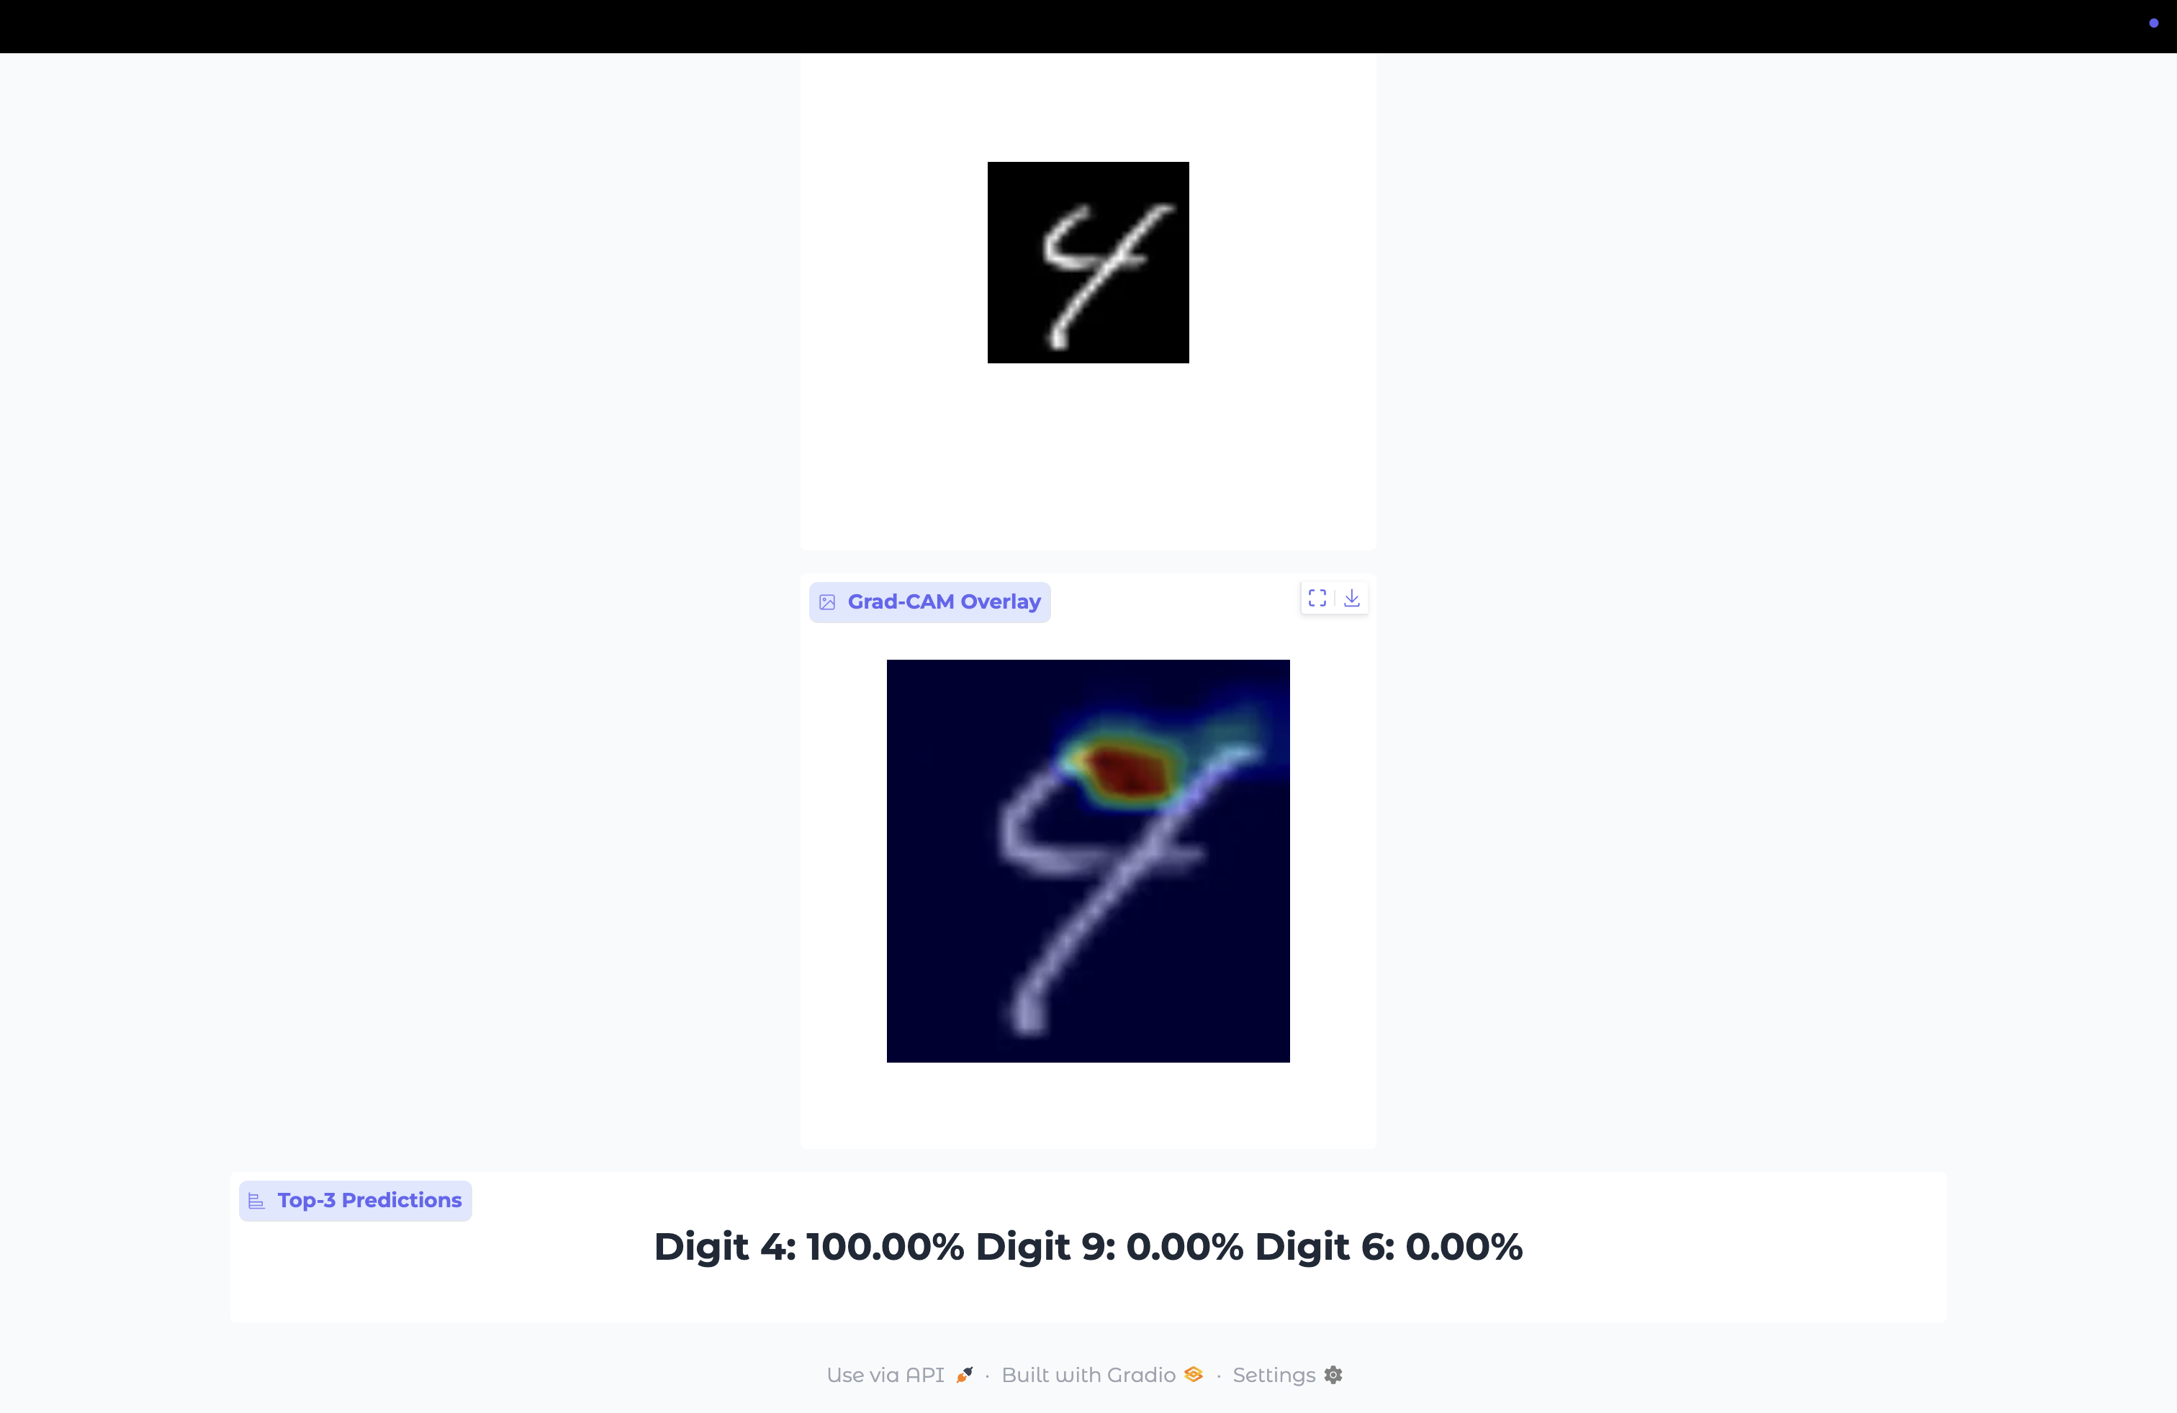
Deployment

Slide 21
Observations
Super-Resolution improved digit clarity, enabling better feature extraction and classification.
Residual connections stabilized training and preserved fine image details.
Attention mechanisms enhanced focus on important features, boosting accuracy.
Dense blocks promoted feature reuse, strengthening both low- and high-level representations.
Multi-path convolutions captured diverse patterns, improving recognition of complex digit structures.

Slide 22
Future Work
Apply the model to more complex datasets like EMNIST or SVHN.
Explore advanced SR techniques such as GAN-based Super-Resolution (e.g., SRGAN).
Integrate perceptual and adversarial loss functions for sharper reconstructions.
Optimize the model for lightweight deployment on mobile and embedded platforms

Slide 23
Conclusion
Enhanced low-resolution MNIST digits using Super-Resolution techniques.
Designed a CNN model with residuals, attention, dense blocks, and multi-path extraction.
Achieved improved digit recognition performance through feature enhancement.
Validated that attention mechanisms and multi-scale feature learning contribute critically to recognizing subtle digit differences.
Demonstrated practical deployment through Gradio App.​

Slide 24
Reference
Zhihao Wang et al., Deep Learning for Image Super-resolution, IEEE​
MNIST Dataset, Yann LeCun​
Gradio Documentation​
TensorFlow and PyTorch Libraries

Slide 25
Thank you

